Slide 1
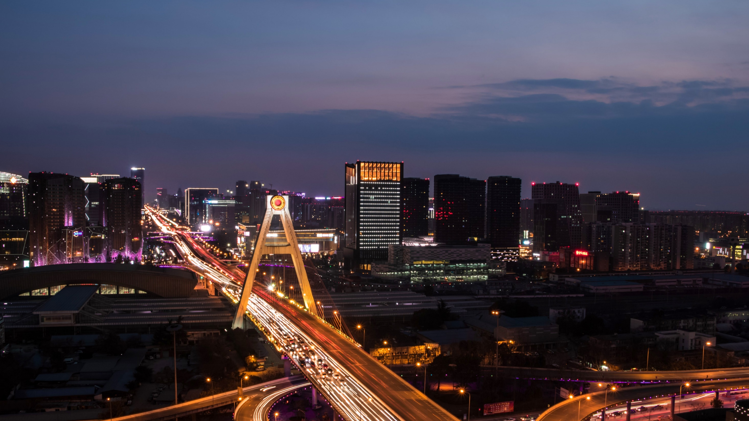
“
Delhi Travel Guide
Explore the Heart of India
Welcome to the ultimate guide to Delhi, India’s vibrant capital! A city where history, culture, modern life, and food come together beautifully.
Discover Delhi with curated information, attractions, tips, and insights!

Slide 2

Introduction
City with rich heritage & modern infrastructure
Cultural festivals & diverse communities
Popular destination for global travelers
Notes:
Enter title

Slide 3
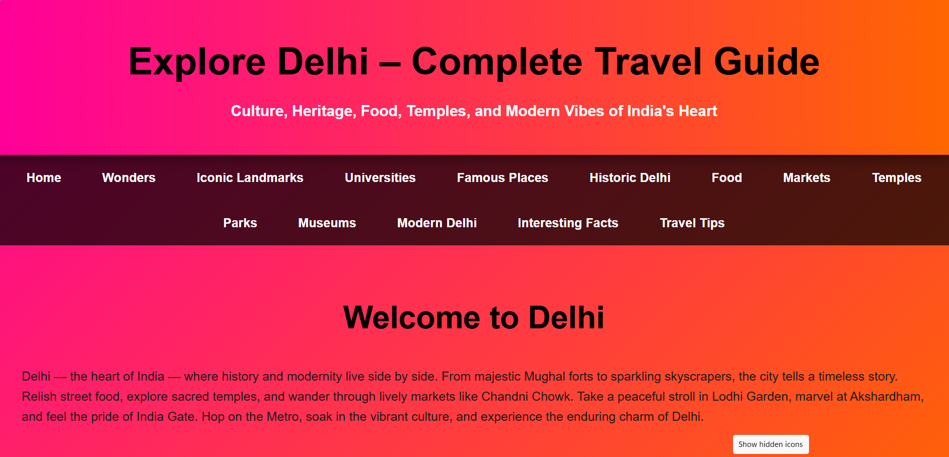
Introduction
City with rich heritage & modern infrastructure
Cultural festivals & diverse communities
Popular destination for global travelers
Notes:
Enter title

Slide 4
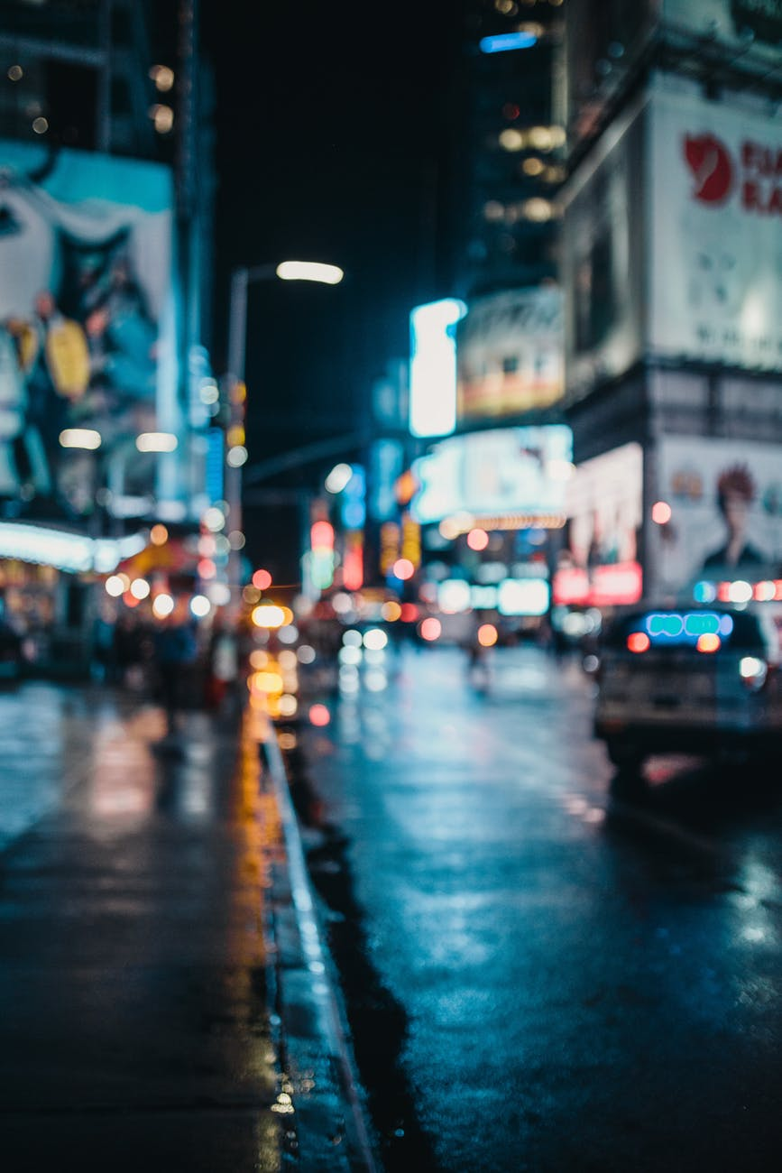
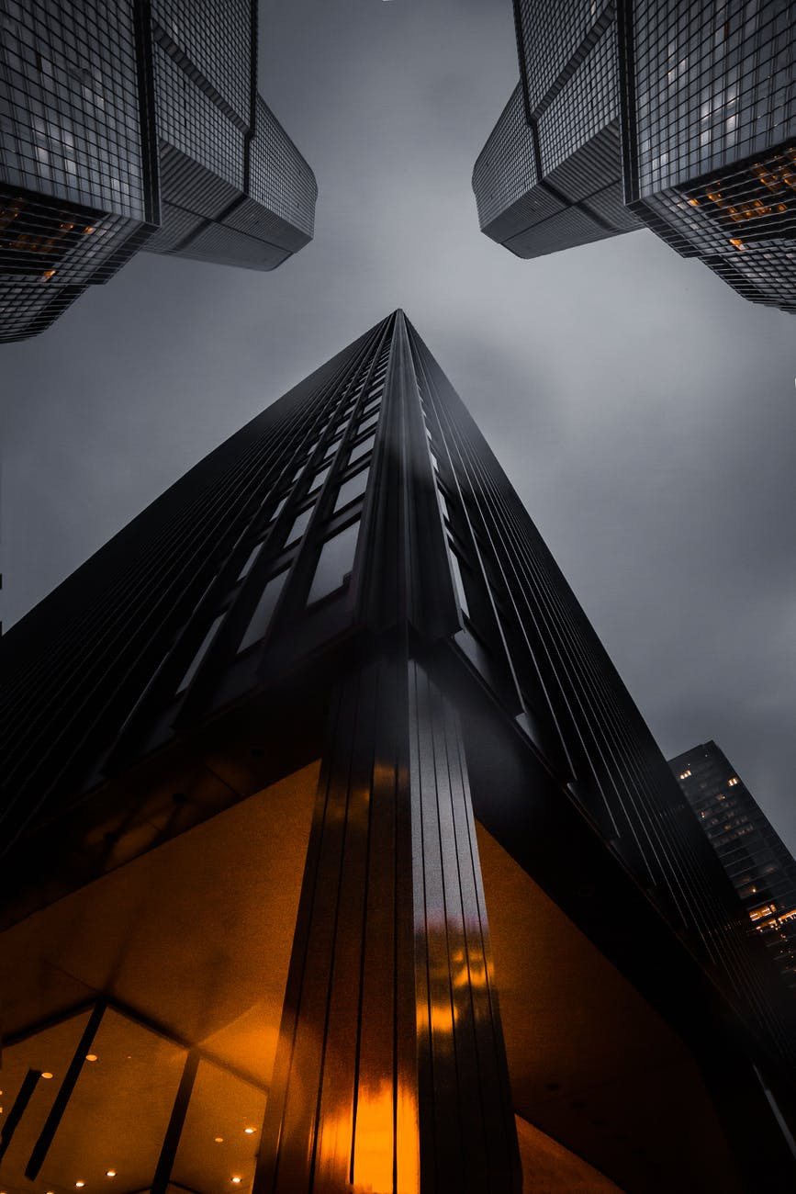
”
Purpose of this Guide
01
98%
Help tourists explore Delhi easily
02
Provide highlights & practical travel tips
03
Showcase culture, food, and attractions

Slide 5
Objectives
Offer a complete travel planning resource
Highlight famous markets & food culture
Promote historic & modern attractions
Encourage tourism experience for everyone

Slide 6


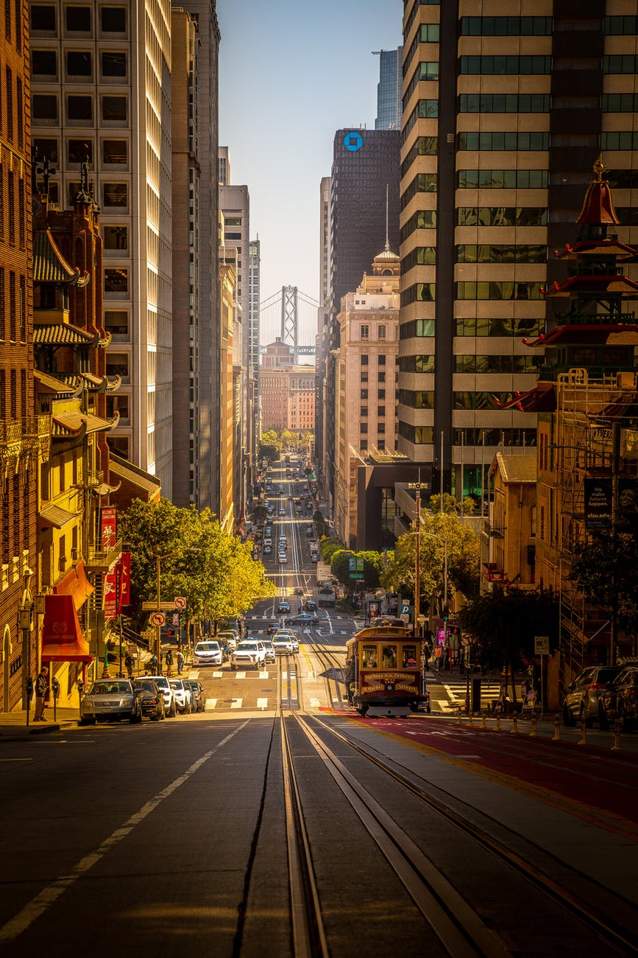
New Delhi Wonders
01
02
03
Gurudwaras, stadiums & major stations
Smooth connectivity & infrastructure
Modern buildings & cultural spots

Slide 7
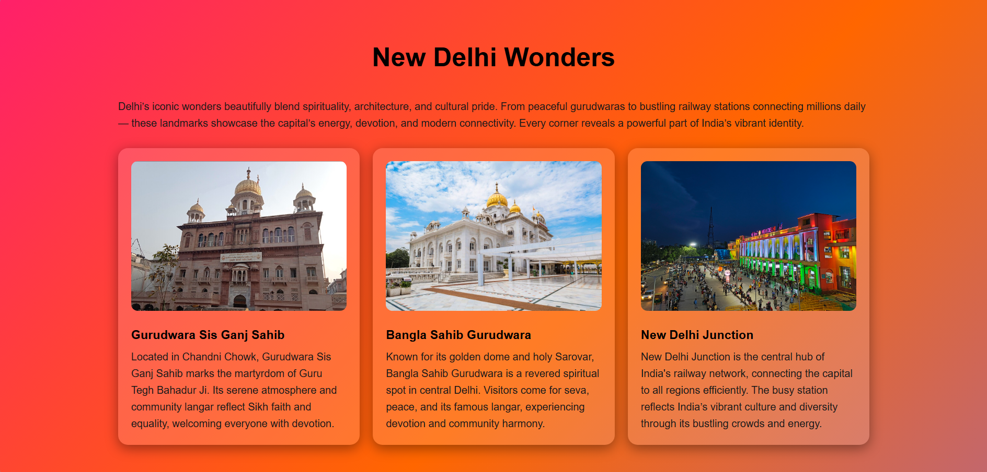
New Delhi Wonders
01
02
03
Gurudwaras, stadiums & major stations
Smooth connectivity & infrastructure
Modern buildings & cultural spots

Slide 8
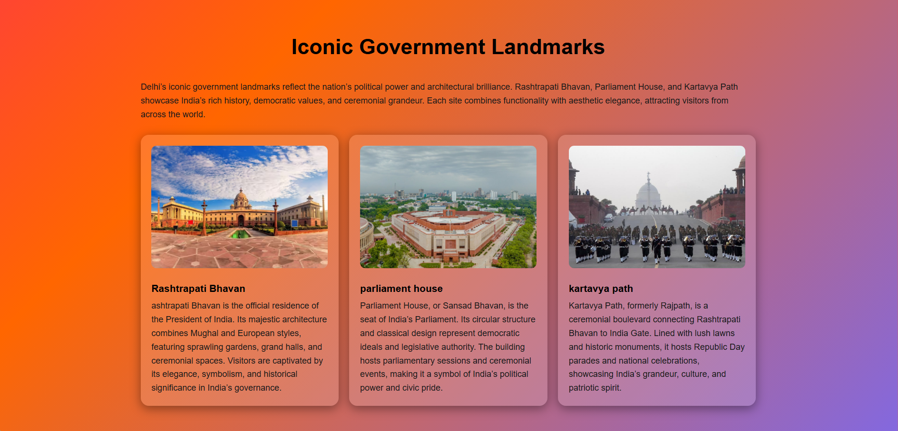
New Delhi Wonders
01
02
03
Gurudwaras, stadiums & major stations
Smooth connectivity & infrastructure
Modern buildings & cultural spots

Slide 9
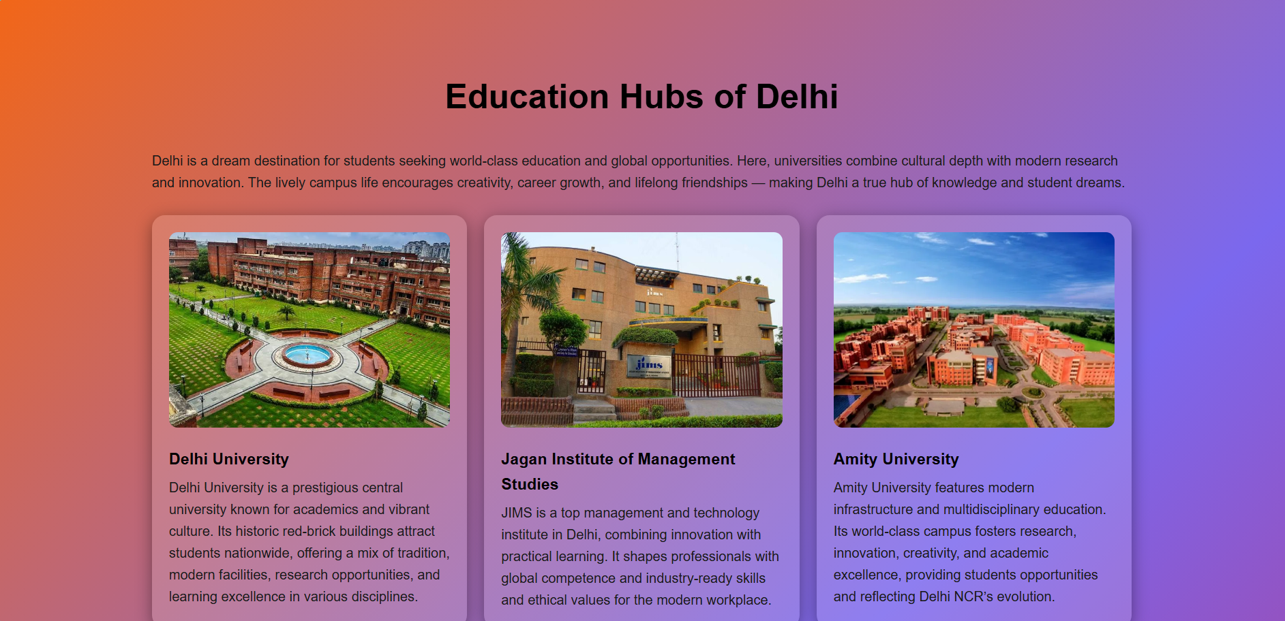
New Delhi Wonders
01
02
03
Gurudwaras, stadiums & major stations
Smooth connectivity & infrastructure
Modern buildings & cultural spots

Slide 10
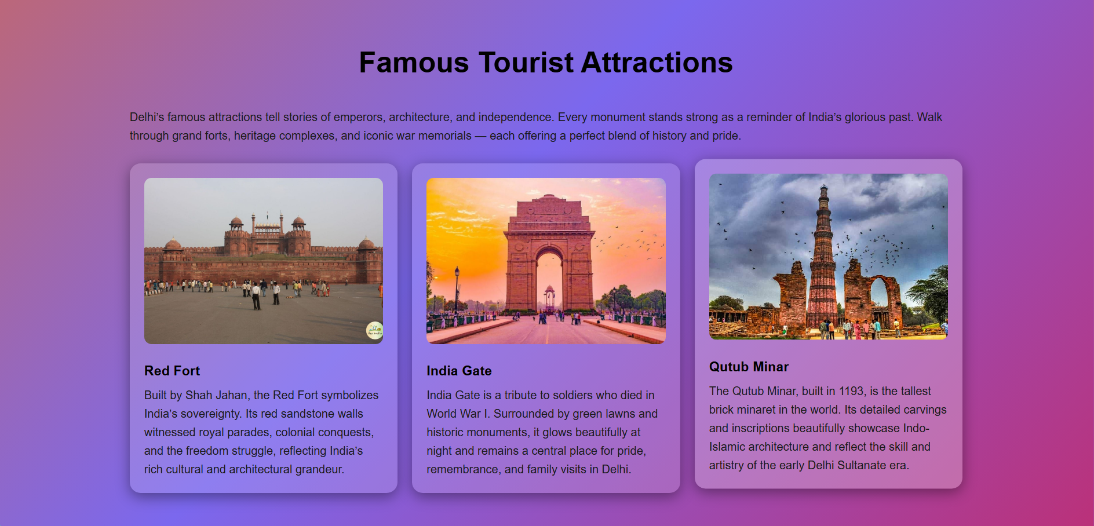
New Delhi Wonders
01
02
03
Gurudwaras, stadiums & major stations
Smooth connectivity & infrastructure
Modern buildings & cultural spots

Slide 11
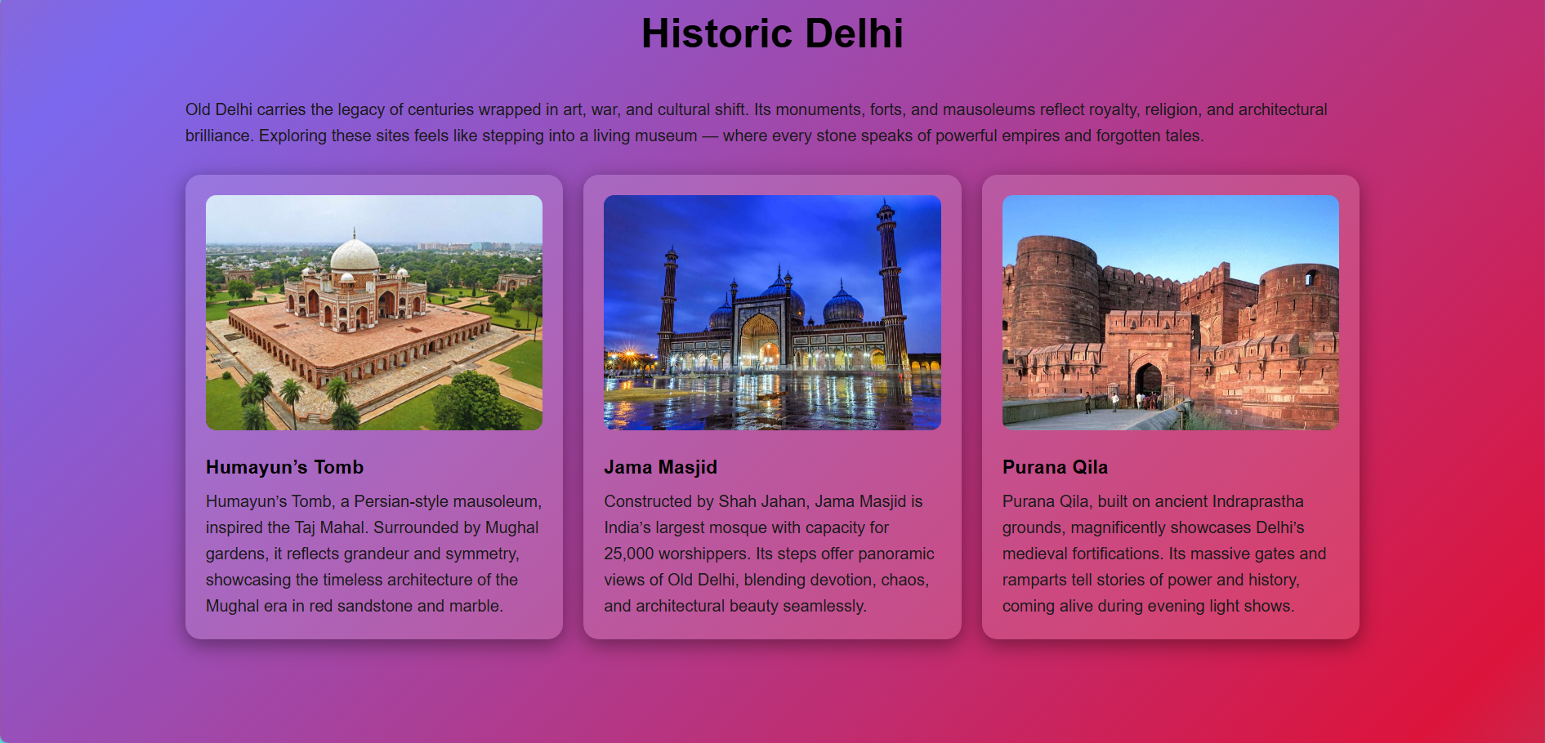
New Delhi Wonders
01
02
03
Gurudwaras, stadiums & major stations
Smooth connectivity & infrastructure
Modern buildings & cultural spots

Slide 12
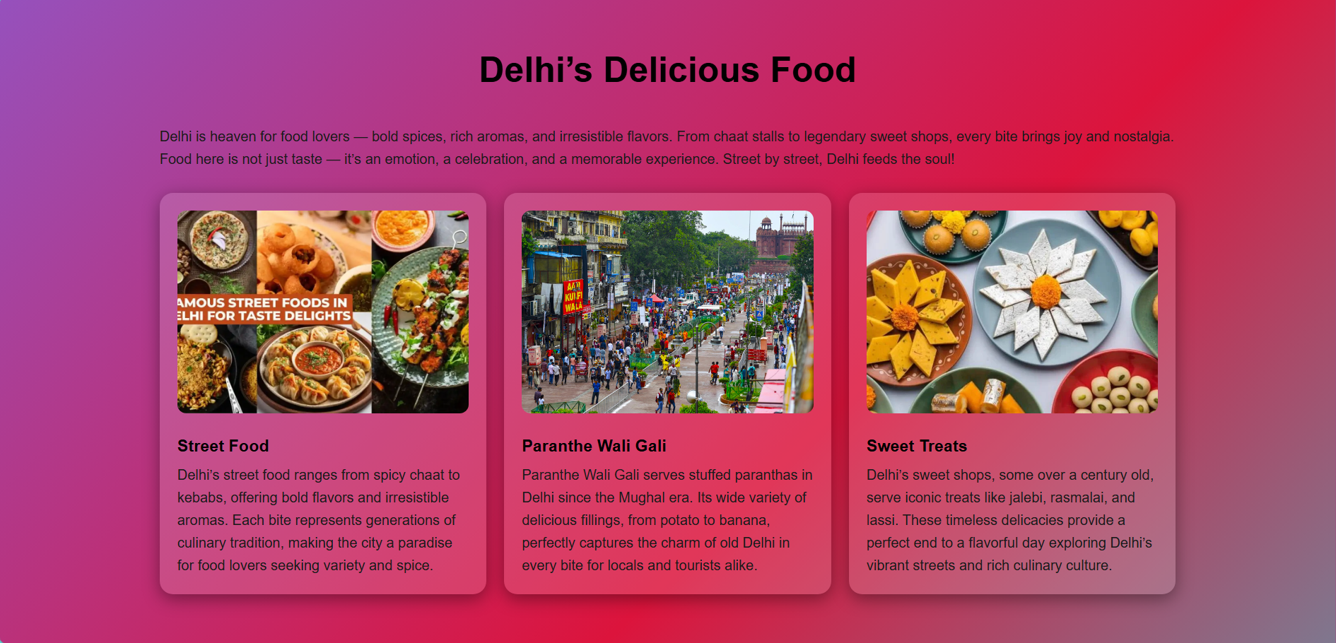
New Delhi Wonders
01
02
03
Gurudwaras, stadiums & major stations
Smooth connectivity & infrastructure
Modern buildings & cultural spots

Slide 13
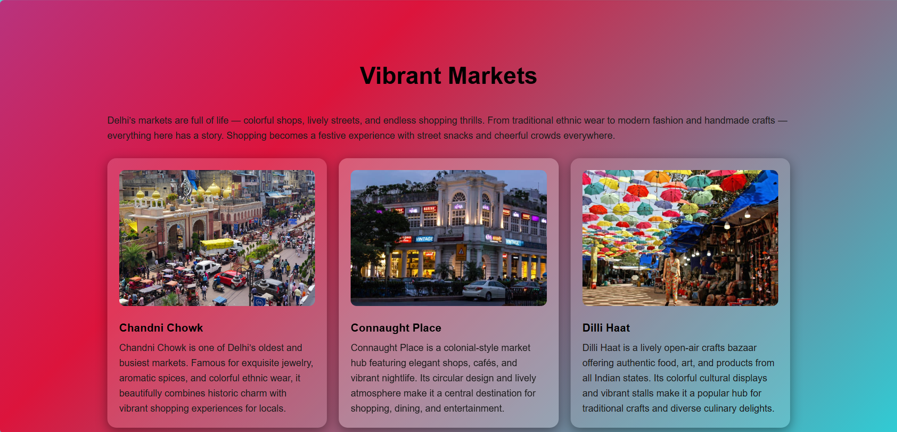
New Delhi Wonders
01
02
03
Gurudwaras, stadiums & major stations
Smooth connectivity & infrastructure
Modern buildings & cultural spots

Slide 14
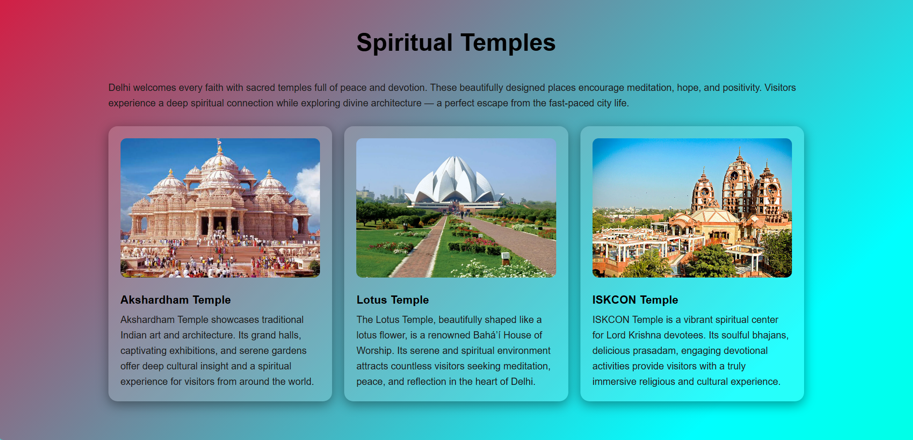
New Delhi Wonders
01
02
03
Gurudwaras, stadiums & major stations
Smooth connectivity & infrastructure
Modern buildings & cultural spots

Slide 15
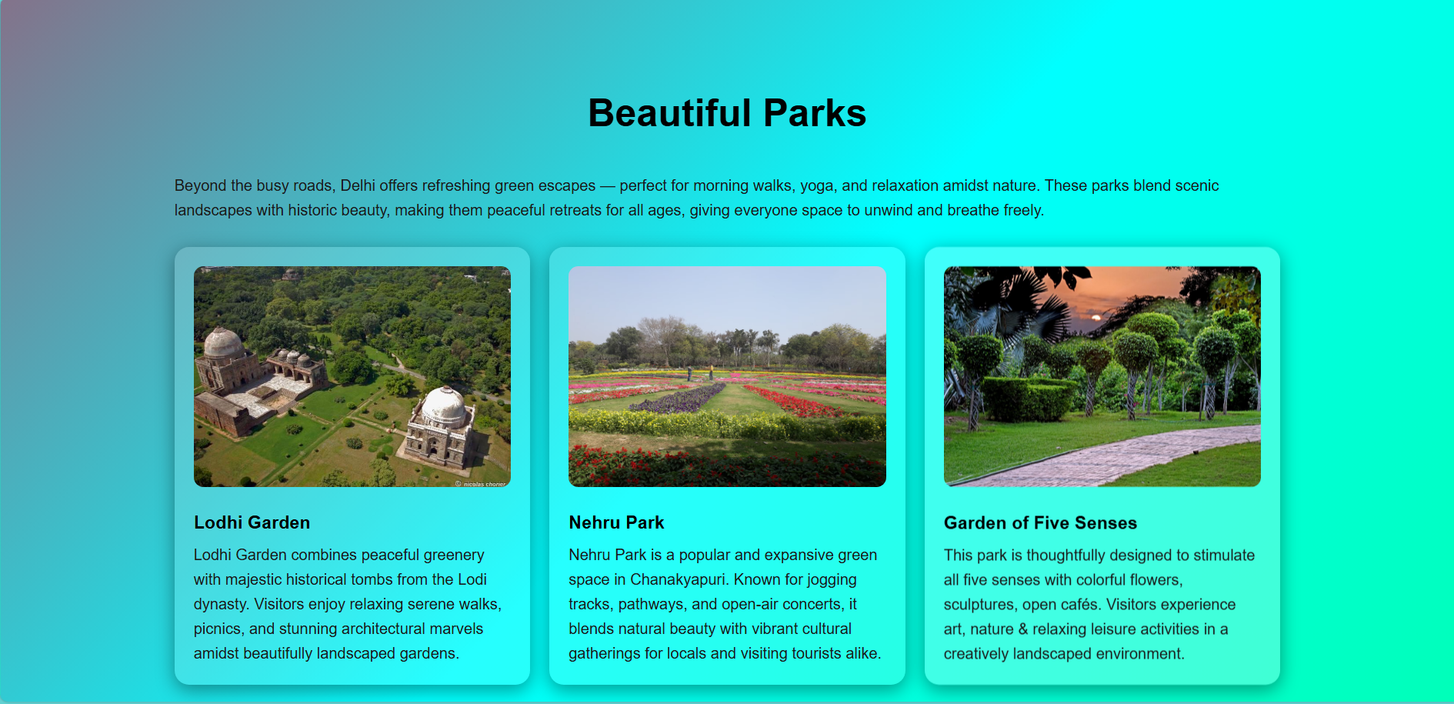
New Delhi Wonders
01
02
03
Gurudwaras, stadiums & major stations
Smooth connectivity & infrastructure
Modern buildings & cultural spots

Slide 16
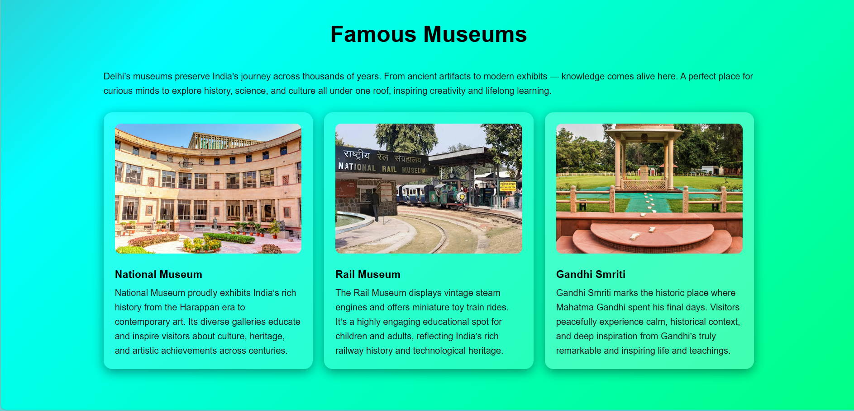
New Delhi Wonders
01
02
03
Gurudwaras, stadiums & major stations
Smooth connectivity & infrastructure
Modern buildings & cultural spots

Slide 17
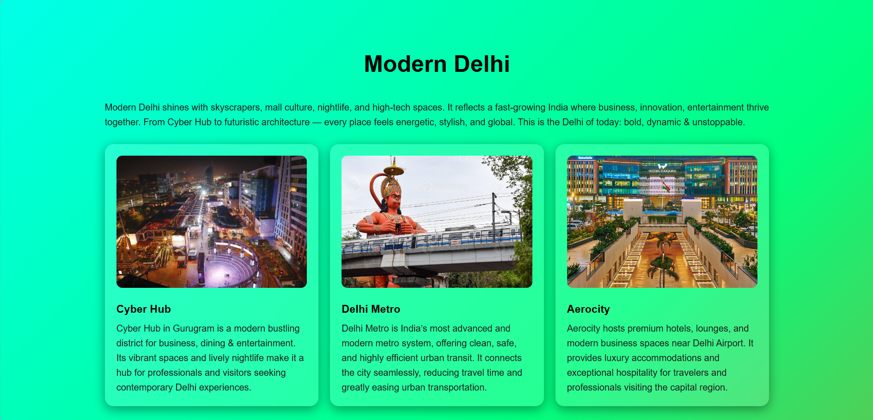
New Delhi Wonders
01
02
03
Gurudwaras, stadiums & major stations
Smooth connectivity & infrastructure
Modern buildings & cultural spots

Slide 18
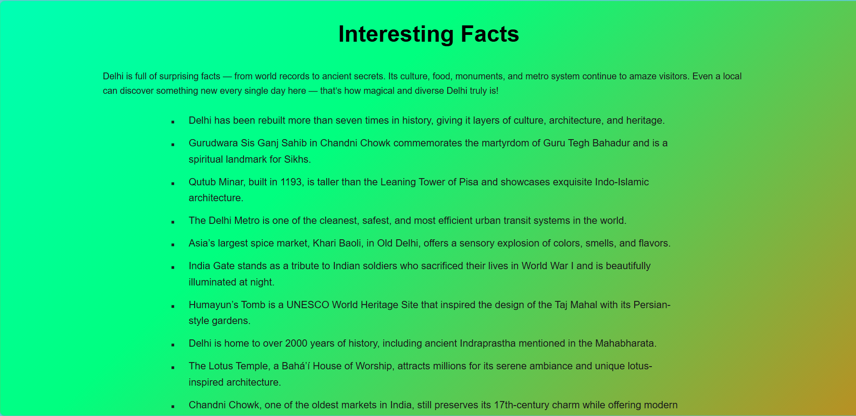
New Delhi Wonders
01
02
03
Gurudwaras, stadiums & major stations
Smooth connectivity & infrastructure
Modern buildings & cultural spots

Slide 19
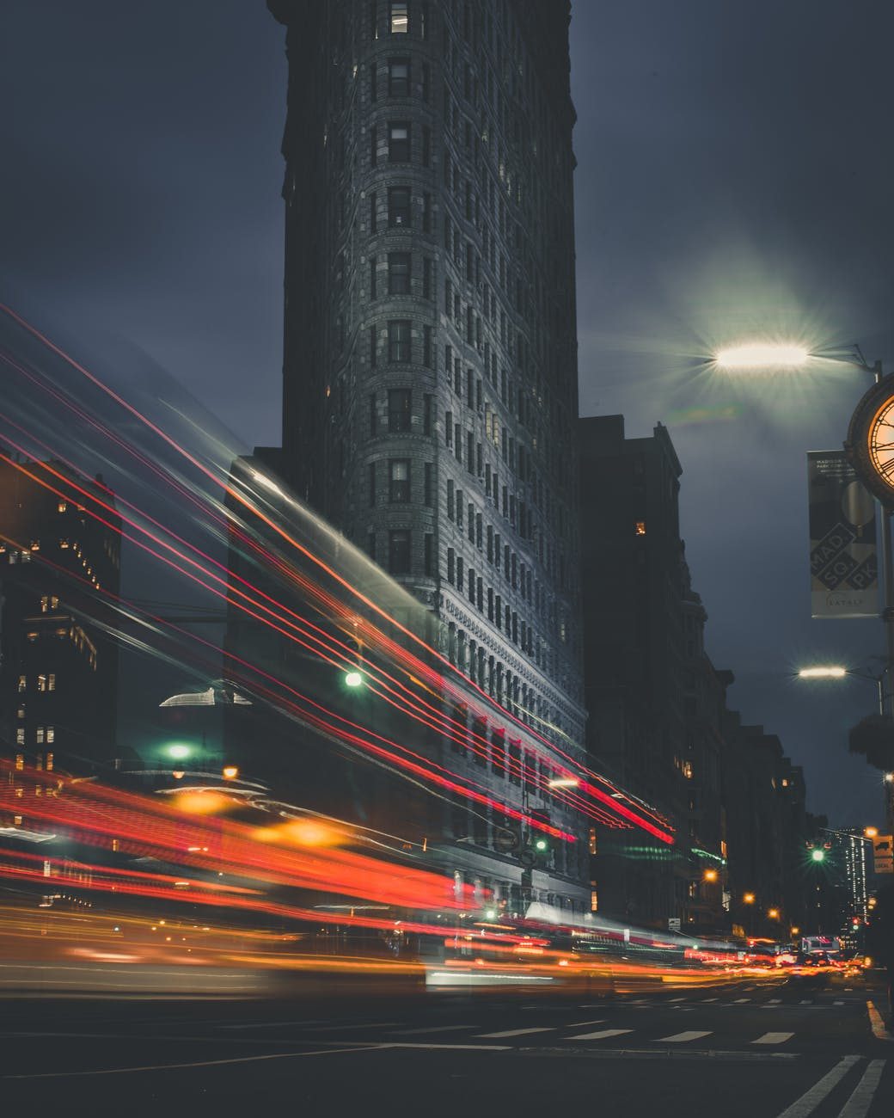
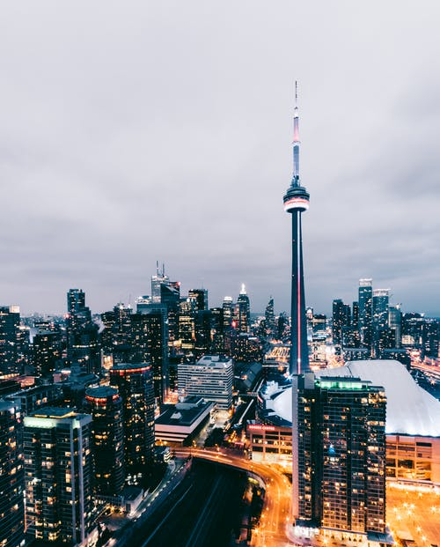
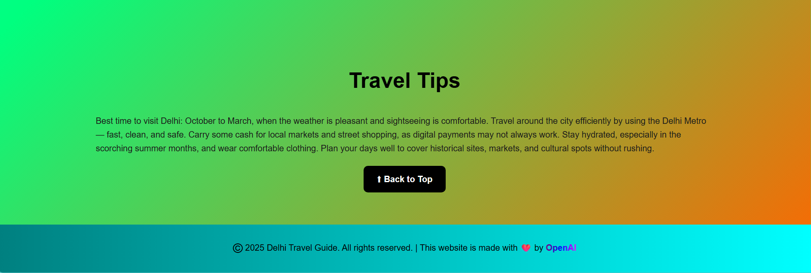
“
Travel Tips
Best to visit: October–March
Use Metro for safe & fast travel
Carry cash for local markets
Stay hydrated & plan routes

Slide 20

Key Features
“
Delhi
Historic + Modern experience
World's top monuments
Food heaven
Green & vibrant city life
”

Slide 21

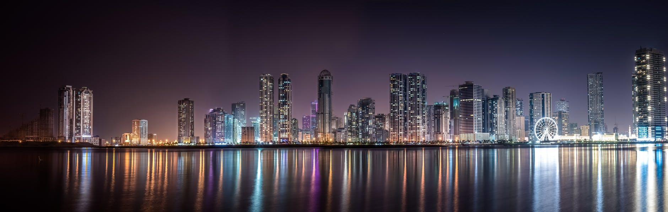
Technologies Used
”
“
HTML, CSS, JavaScript
Responsive web design
Smooth scroll & UI enhancements

Slide 22

“
Future Enhancements
Interactive maps
Virtual tours & videos
Mobile responsiveness boost
Multi-language support
”
freedom

Slide 23
“
Guide Overview & Final Words
Categorized navigation
Attractions, food, parks, markets
Easy-to-read & user-friendly layout
Delhi = Culture + Modernity
Perfect travel destination
Memories & experiences for all travelers

Slide 24

DELHI
“
”

Slide 25
Thank You!
“
Every great presentation is complete with a great audience — and that’s you!
Thank you for your attention!
For feedback, improvements, or project collaboration:

